Slide 1
Title
Title
Title
1st or 2nd Author/Presenter
Affiliation
Corresponding email
1st or 2nd Author/Presenter
Affiliation
Corresponding email
1st or 2nd Author/Presenter
Affiliation
Corresponding email

Slide 2
Abstract
An abstract is a brief summary of a research paper, article, or project that highlights the main objectives, methods, results, and conclusions. It helps readers quickly understand the purpose and key findings of the work, allowing them to decide whether to read the full document.
Presentations are communication tools that can be used as demonstrations, lectures, speeches, reports, and more. It is mostly presented before an audience.

Slide 3
Introduction

Slide 4
Problem
Hypothesis
Presentations are communication tools that can be used as demonstrations, lectures, speeches, reports, and more. It is mostly presented before an audience. It serves a variety of purposes, making presentations powerful tools for convincing and teaching.
Presentations are communication tools that can be used as demonstrations, lectures, speeches, reports, and more. It is mostly presented before an audience. It serves a variety of purposes, making presentations powerful tools for convincing and teaching.

Slide 5
Objectives
Presentations are communication tools that can be used as demonstrations, lectures, speeches, reports, and more. It is mostly presented before an audience.
Presentations are communication tools that can be used as demonstrations, lectures, speeches, reports, and more. It is mostly presented before an audience.
Presentations are communication tools that can be used as demonstrations, lectures, speeches, reports, and more. It is mostly presented before an audience.

Slide 6
01
Presentations are communication tools that can be used as demonstrations, lectures, speeches, reports, and more. It is mostly presented before an audience.
Significance of the Study
Presentations are communication tools that can be used as demonstrations, lectures, speeches, reports, and more. It is mostly presented before an audience.
02
03
Presentations are communication tools that can be used as demonstrations, lectures, speeches, reports, and more. It is mostly presented before an audience.

Slide 7
Methodology

Slide 8
Quantitative Method
Presentations are communication tools that can be used as demonstrations, lectures, speeches, reports, and more. It serves a variety of purposes, making presentations powerful tools for convincing and teaching.
Qualitative Method
Presentations are communication tools that can be used as demonstrations, lectures, speeches, reports, and more. It serves a variety of purposes, making presentations powerful tools for convincing and teaching.

Slide 9
PHASE 1
Presentations are communication tools that can be used
as demonstrations, lectures, speeches, reports, and more.
Research Timeline
PHASE 2
Presentations are communication tools that can be used
as demonstrations, lectures, speeches, reports, and more.
PHASE 3
Presentations are communication tools that can be used
as demonstrations, lectures, speeches, reports, and more.
PHASE 4
Presentations are communication tools that can be used
as demonstrations, lectures, speeches, reports, and more.

Slide 10
Data Collection Methods
STEPS AND ACTION ITEMS
STEP 1
STEP 2
STEP 3
Presentations are communication tools that can be used as demonstrations, lectures, speeches, reports, and more.
It is mostly presented before an audience. It serves a variety of purposes, making presentations powerful tools for convincing and teaching.
Presentations are communication tools that can be used as demonstrations, lectures, speeches, reports, and more.
It is mostly presented before an audience. It serves a variety of purposes, making presentations powerful tools for convincing and teaching.
Presentations are communication tools that can be used as demonstrations, lectures, speeches, reports, and more.
It is mostly presented before an audience. It serves a variety of purposes, making presentations powerful tools for convincing and teaching.

Slide 11
Results of
the Study

Slide 12
Qualitative Analysis
DESCRIPTIVE OUTCOMES OF THE STUDY
Presentations are communication tools that can be used as demonstrations, lectures, speeches, reports, and more. It is mostly presented before an audience. It serves a variety of purposes, making presentations powerful tools for convincing and teaching.
Presentations are communication tools that can be used as demonstrations, lectures, speeches, reports, and more. It is mostly presented before an audience. It serves a variety of purposes, making presentations powerful tools for convincing and teaching.

Slide 13
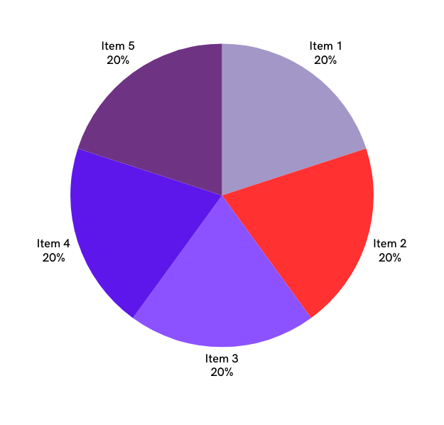
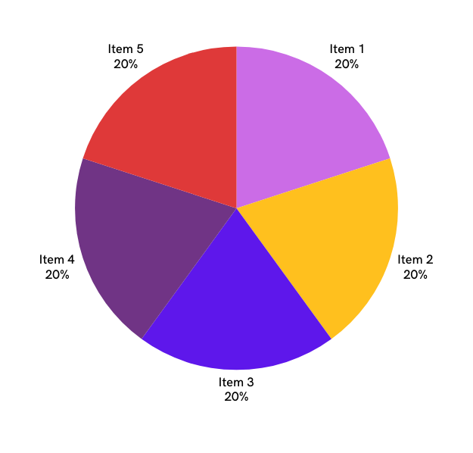
Quantitative Analysis

Slide 14
Results
New understanding
of the problem
Presentations are communication tools that can be used as demonstrations, lectures, speeches, reports, and more.
UNCOVERED KEY RESEARCH TRENDS
Significant Findings
Presentations are communication tools that can be used as demonstrations, lectures, speeches, reports, and more.
Presentations are communication tools that can be used as demonstrations, lectures, speeches, reports, and more.

Slide 15
Conclusion

Slide 16
Presentations are communication tools that can be used as demonstrations, lectures, speeches, reports, and more. It serves a variety of purposes, making presentations powerful tools for convincing and teaching.
To create a stunning presentation, it's best to simplify your thoughts. You can then organize them into your introduction, your main content, and your conclusion.
Study Limitations

Slide 17
Recommendations
Presentations are communication tools that can be used as demonstrations, lectures, speeches, reports, and more.
It is mostly presented before an audience. It serves a variety
of purposes, making presentations powerful tools for convincing and teaching.

Slide 18
END OF PRESENTATION
Thank you!

